Slide 1

Apache Cordova
CSCI 641/541 – Programming Skills
Building Cross Platform Using Web Technologies
Aamir Jamal Nabiha Raza Komal Sorte

Slide 2
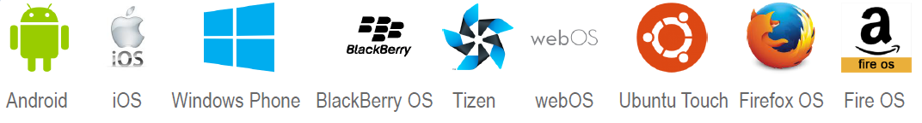
Objective
Target multiple platforms with one code base
Write Once Run Anywhere

Slide 3
Roadmap
History
What, Why, Where?
Cordova Architecture
Environment Set-up
Demo: First application
Demo: Multi-Feature Application
Xcode and IOS
References

Slide 4

History

Slide 5


1996 palm-palmpilot
1999 blackberry limited email and limited browsing
2007 Iphone
2008 android
2009 windows phone
2010 iPad
Huge change over that 4 year period
Apache Cordova was originally called Phonegap built by Nitobi.
Open-source & free-software, Apache License

Slide 6
What? Why? Where?

Slide 7
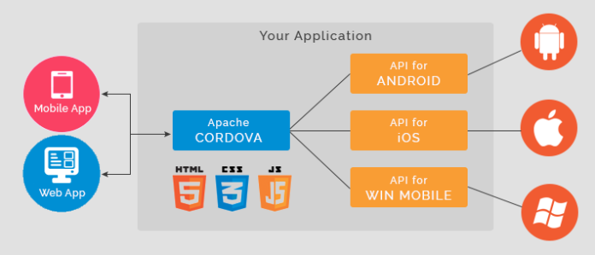
Companies/Organizations working on this technology:
Rochester Institute Of Technology, Microsoft, IBM, Vodafone and around 500 more companies
Real Time Applications:
Wikipedia Application(using PhoneGap), Facebook, Salesforce, Pacifica, FanReact, Series Seven, etc
Used in various sectors such as healthcare, automation, entertainment, etc

Slide 8
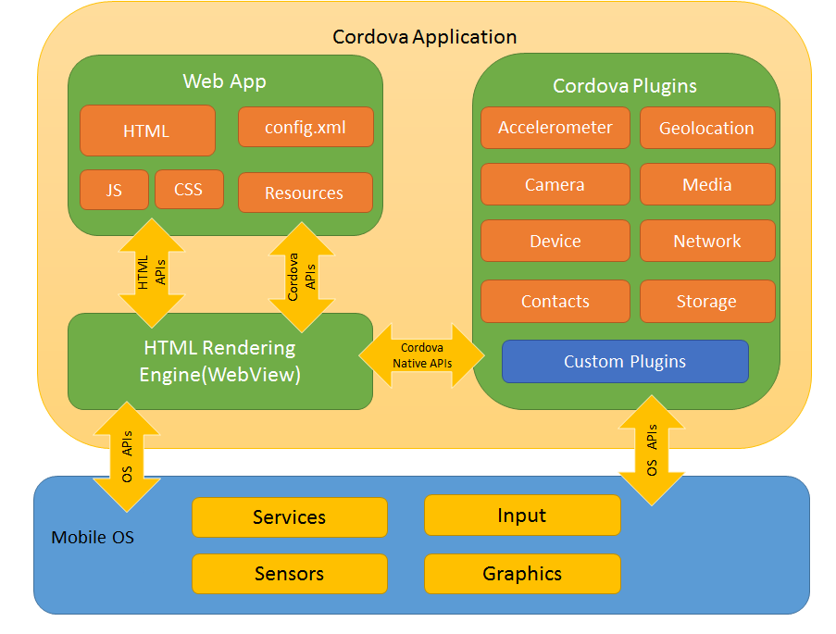

Slide 9

Environment Set-Up

Slide 10
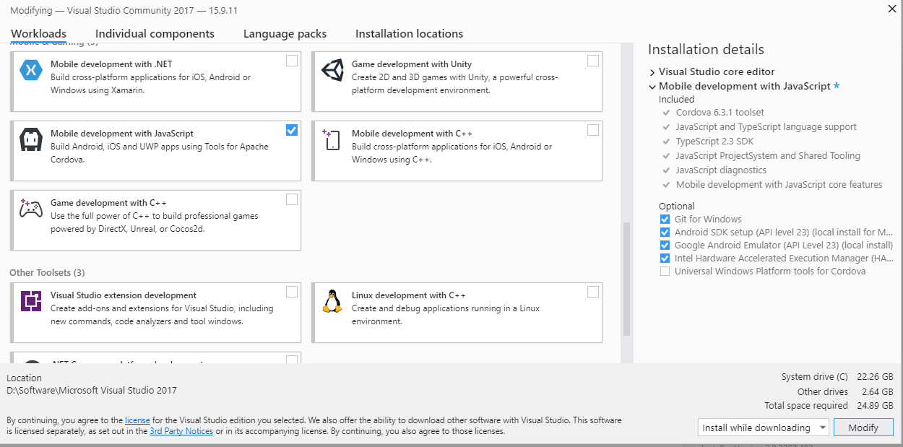
Install Visual Studio 2017 and add following package:
Depending on your specific development needs, you may need to install additional, optional components. For example, to support Android application development you'll need to add support for the Android SDK. To test Android apps on emulators, you’ll need to add support for the Google Android Emulator

Slide 11


Demo: First Application
Change Color On Click
Change Color On Shake

Slide 12
Steps
Installing Cordova
Create a project
Add a platform
Run your application

Slide 13
Plugins Available Out Of The Box
Battery File Transfer
Camera Geolocation
Capture Globalization
Console InAppBrowser
Contacts Media
Device Network Information
Device Motion Notification
Device Orientation Splash Screen
File Status Bar

Slide 14
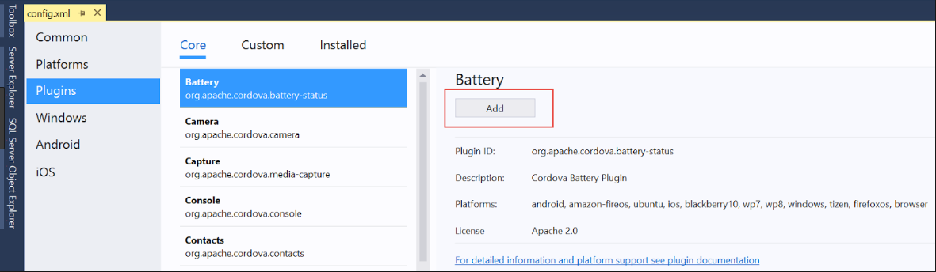
How to Use Plugins
Step 1: Installing Plugin:
If CLI - cordova plugin add cordova-plugin
If VS – add using config.xml
Step 2: Add UI (Optional)
Step 3: Add Event Listeners
Step 4: Create Callback Function

Slide 15
Demo: Multi-Feature Application
Plugins Covered:
Camera Battery Shake
Device Motion Accelerometer

Slide 16

References
https://cordova.apache.org/docs/en/latest/guide/overview/index.html
https://www.youtube.com/watch?v=kqWZuEpHoSw&list=PLReL099Y5nRd9BNsMZwXvTDeqnfRMiGJy&index=1
https://visualstudio.microsoft.com/vs/older-downloads/
https://docs.microsoft.com/en-us/visualstudio/cross-platform/tools-for-cordova/first-steps/build-your-first-app?view=toolsforcordova-2017
https://dzone.com/articles/who-uses-phonegapapache

Slide 17
Questions
?

Slide 18

Thank You
Aamir Jamal Nabiha Raza Komal Sorte
aj1243@rit.edu nr6024@rit.edu ks7229@rit.edu

